Slide 1
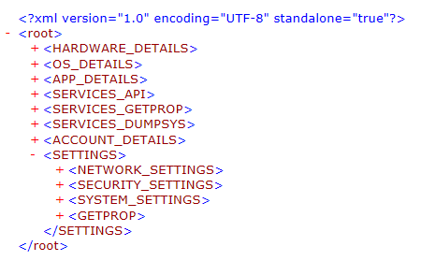
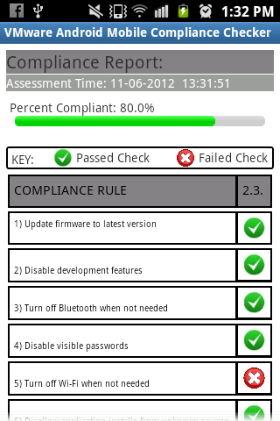
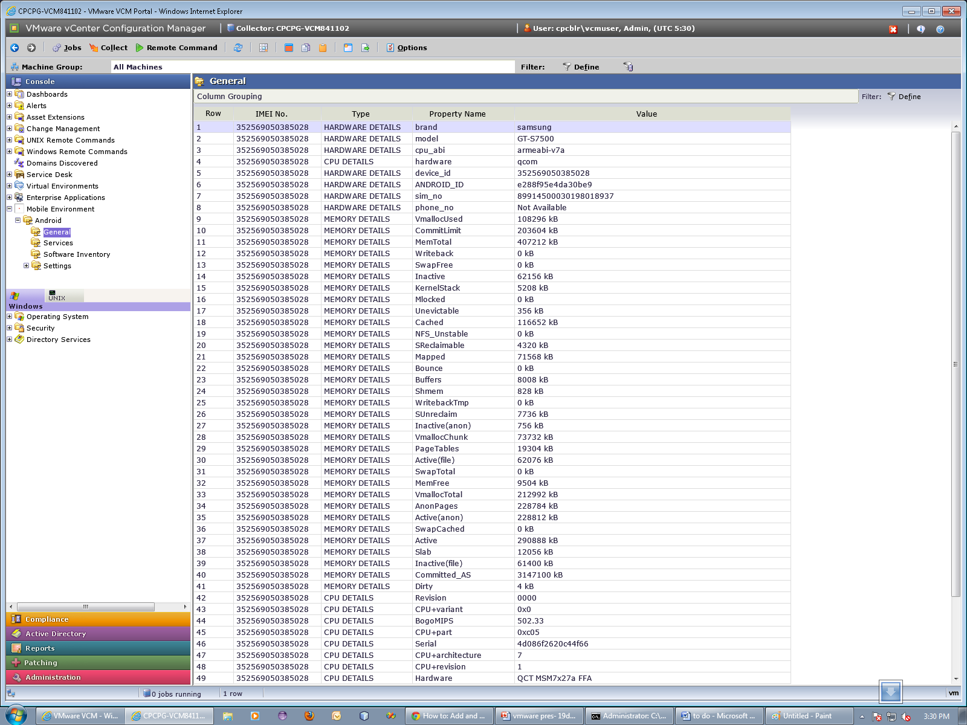
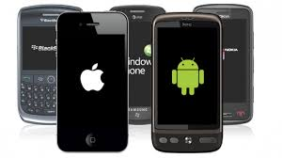
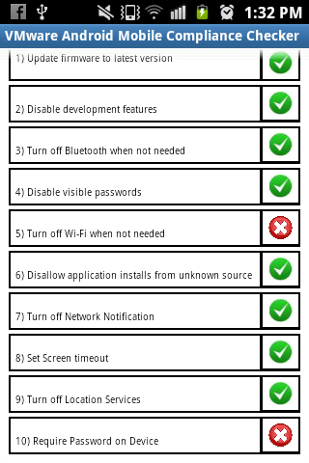
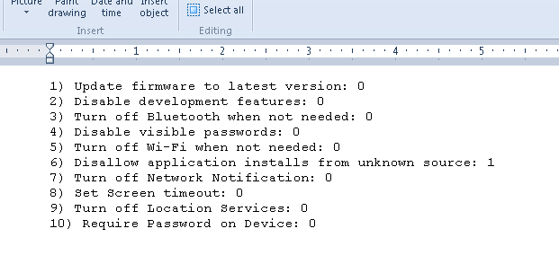
c
The Compliance Report on the Android App Screen
A mock screen on VCM
Android Device Information Collection – the XML with all the available information
MOBILE COMPLIANCE CHECKER
The Report is saved on the device sdcard and then pushed onto the specified server for assessment

Slide 2
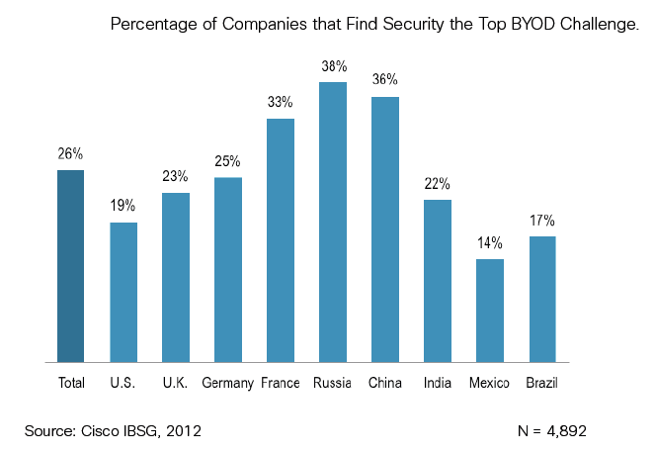
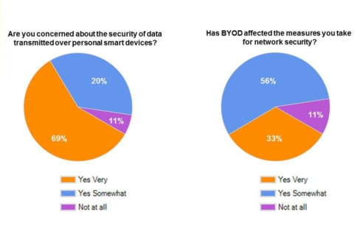
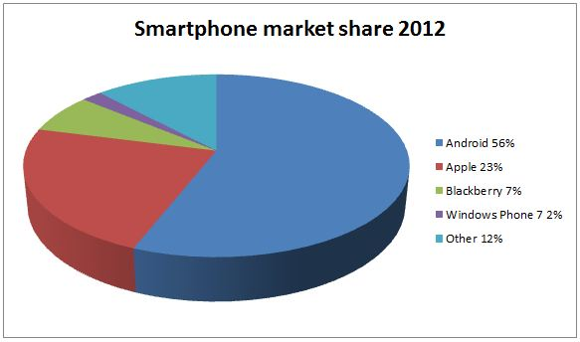
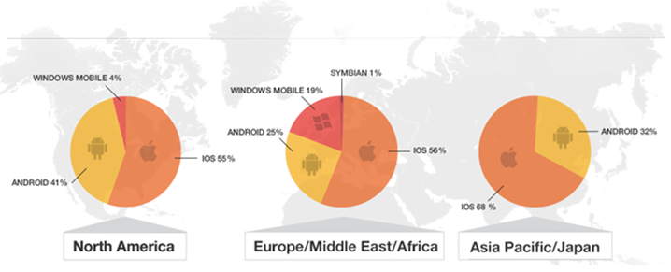
Trends….
MOBILE COMPLIANCE
Concerns…
81% of the employed adults use at least one personally owned electronic device for business use
50% companies have experienced a data breach due to insecure devices
< 10% of the organizations are fully aware of the devices accessing their network
Apple shipped more iPADS in 2 years than macs in over 20 years
By 2015 mobile app development projects will outnumber native PC projects by a ratio of 4-to-1.
Corporate Market Share
$429,000. Typical large company loss due to mobile computing mishaps in 2011
Gartner expects worldwide sales of smartphones to dominate the overall market in 2013 — reaching close to one billion units
The need is to ensure compliance of mobile devices to corporate policies
DISA and CIS have proactively rolled out Security Configuration Benchmarks for Mobile Device OS – Android, iOS, BlackBerry, Symbian and Windows Mobile. PCI Regulations would extend to include m-commerce

